Slide 1
Wireframes Mockups Prototypes
Tim Franklin

Slide 2

TIM FRANKLIN
User Experience Architect, Gravitate Solutions
BS in CIS, MO State 2005
15 years UI-centric development
DNUG Supreme Chancellor

Slide 3
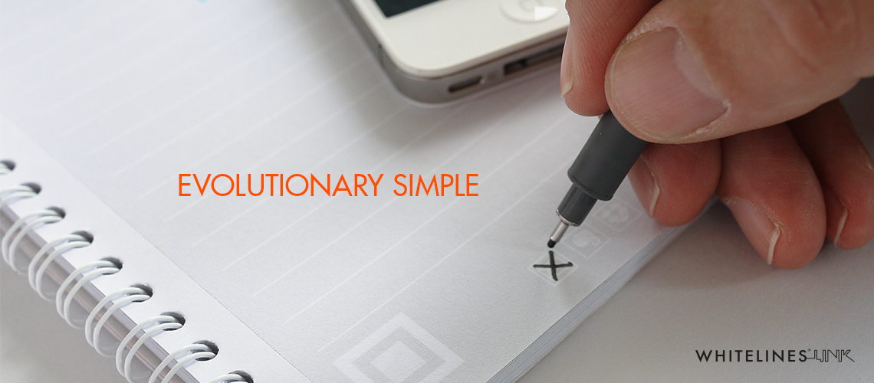
Wireframes
Low fidelity
Quick to create, modify, and crumple
Emphasizes workflows, high level ideas
Sketches imply temporal ideas

Slide 4
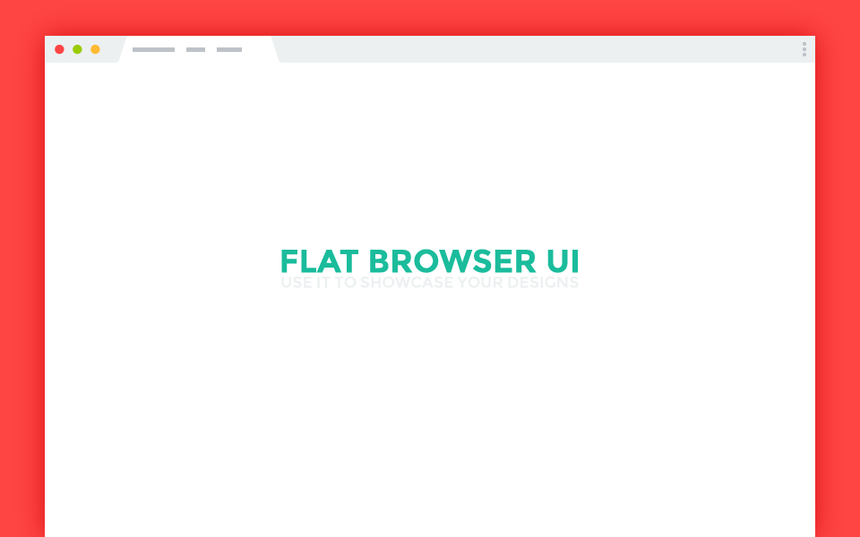
Mockups
Middle to high fidelity
Static, “skinned” (branded)
Emphasizes visuals, content
Comps exhibit more true-to-life design

Slide 5
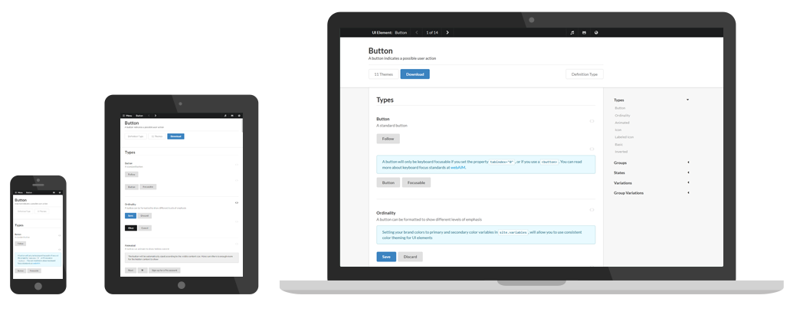
Prototypes
Middle to high fidelity
Interactive, appears functional
Experience content, functionality
Pseudo-working code; the closest to actual user experience

Slide 6

… But I’m a Developer

Slide 7

What do I do with this?
Clarify expectations of how closely the design should be translated
Stakeholder indifference !== stakeholder mandate
Consider branding style guides, UX best practices
Raise the red flag for concerns
Build to spec, sweat the details

Slide 8
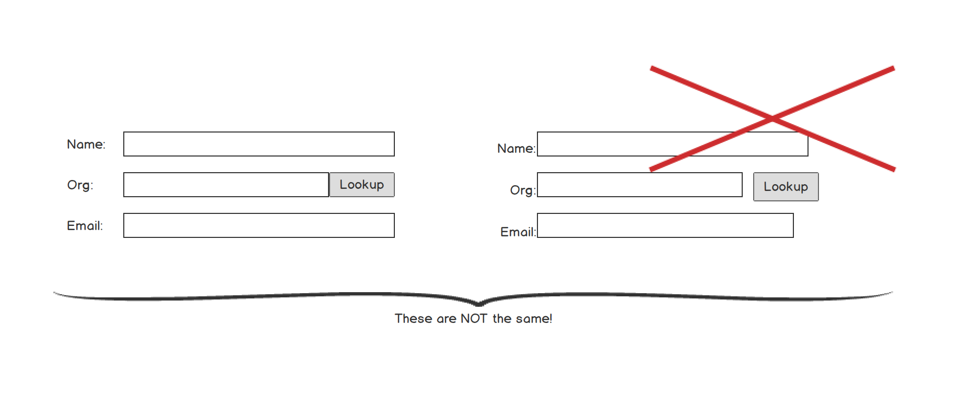

Slide 9
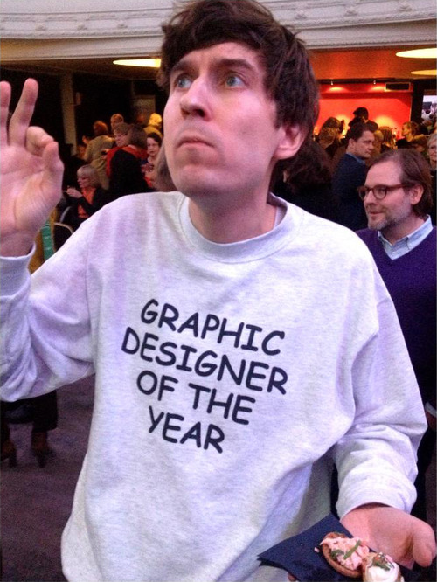
I’ll give it a go…

Slide 10
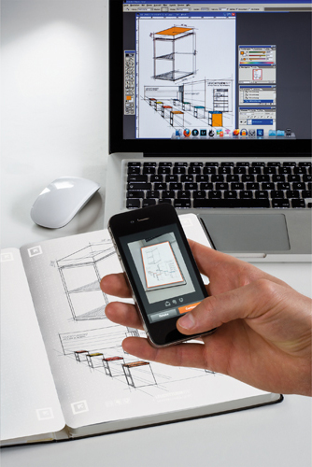
Design Tools
creativebloq.com/wireframes/top-wireframing-tools-11121302
Moleskin graphing notebook, Whitelines notebook
Balsamiq, InVision, Atomic, Visio
Adobe Photoshop, InDesign, Experience Design

Slide 11
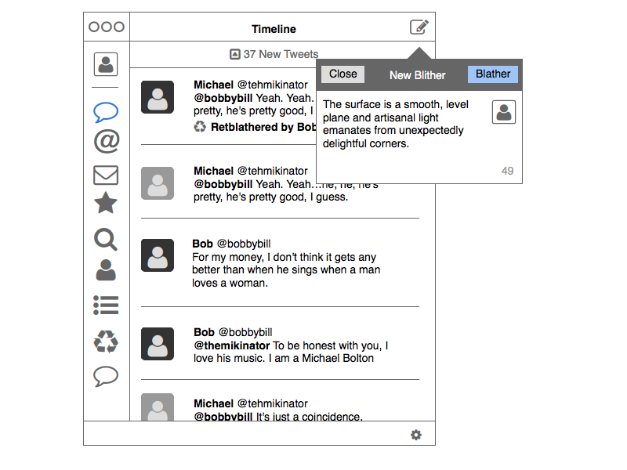
Balsamiq Mockups
Desktop ($89/user) Cloud ($12/mo) Google Drive ($5/mo/user)
77 built-in controls
Reusable assets, symbols
Project-based
Export to PDF
Collaboration
mockupstogo.mybalsamiq.com/projects

Slide 12
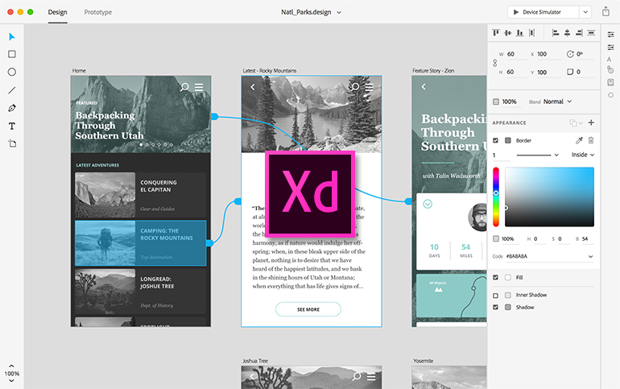
Adobe Xd: Experience Design
Single App ($20/mo) All Apps ($50/mo) All Apps Ed ($20/mo)
Part of Adobe Creative Cloud
Preview release (Mac OS X only, for now)
Draw, reuse, remix elements
UI Kits for iOS, Google Material, Win 10
Interactions and animations
CC sharing
adobe.com/products/experience-design.html

Slide 13
Questions?
designmodo.com/wireframing-prototyping-mockuping/
whitelinks.se
365webresources.com/20-web-mobile-browser-psd-mockups-showcasing-projects/
semantic-ui.com
getbootstrap.com
balsamiq.com
Tim Franklin
pureux@gmail.com
twitter.com/pureux
facebook.com/tim.franklin
linkedin.com/in/tcfranklin

